Slide 1
Comparative Analysis of NoSQL and Relational DBMS
Neo4j vs PostgreSQL
Data Management A.Y. 2023-2024
Prof.Maurizio Lenzerini
Dr.Roberto Maria Delfino
Alessandro Miragliotta
1837025

Slide 2
Agenda
Dataset
System and Tools
Loading Data
Queries
Throughput
Results
Conclusions

Slide 3
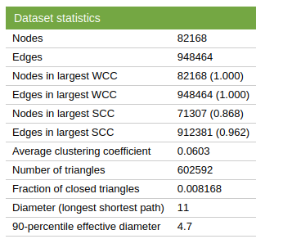
Dataset
The selected dataset states relationships between users of a social network. Users are represented as integers. It can be downloaded from here

Slide 4



System and Tools
OS: 64 bit
CPU: i7-8550U@ 1.80GHz
RAM: 8GB
PostgreSQL 14.12
Neo4J 1.6.0

Slide 5
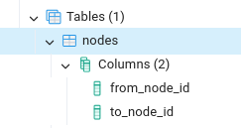
Loading Data - PostgreSQL
COPY nodes FROM '/path/to/your/file.csv' DELIMITER ',' CSV HEADER;

Slide 6
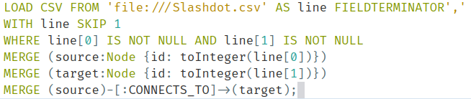
Loading Data - Neo4J
Here I load the csv creating a relationship CONNECTS_TO between the source (id first column value) and the target (id second column value)

Slide 7
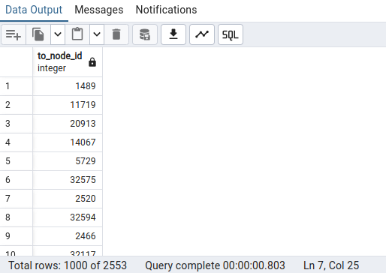
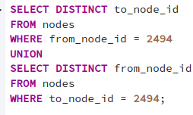
Find Nodes Connected to a Specific Node - PSQL
Execution Time: 803ms

Slide 8
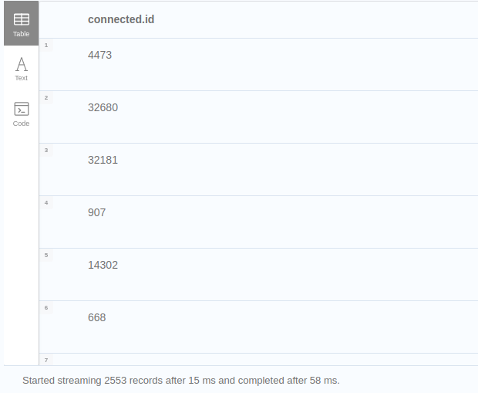
Find Nodes Connected to a Specific Node – Neo4J
Execution Time: 58ms

Slide 9
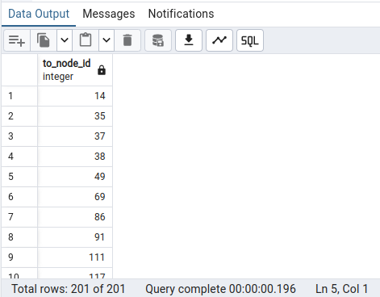

Find Common Connections Between Two Nodes – PSQL
Execution Time: 196ms

Slide 10
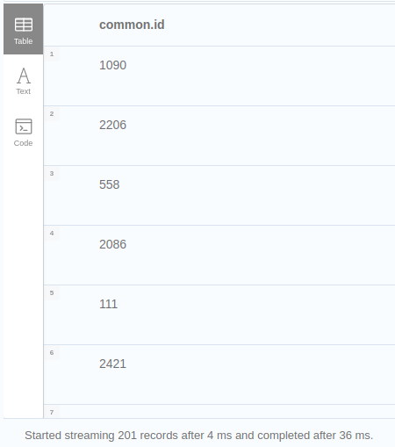
Find Common Connections Between Two Nodes – Neo4J
Execution Time: 36ms

Slide 11
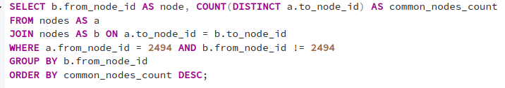
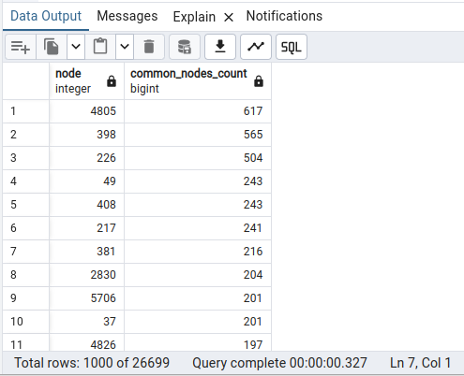
Find the number of common nodes with node 2494 for every other node - PSQL
Execution Time: 327ms

Slide 12
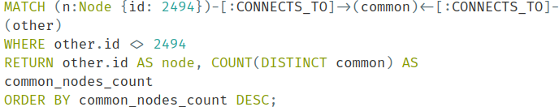
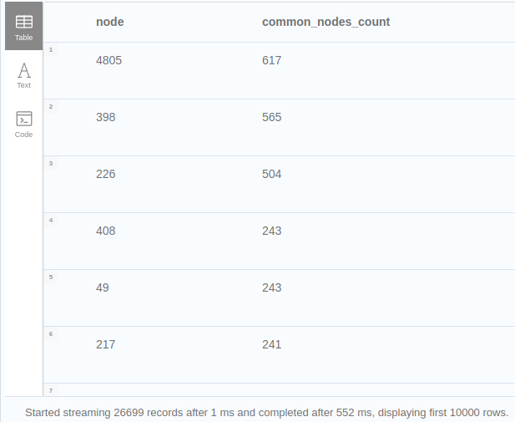
Find the number of common nodes with node 2494 for every other node - Neo4J
Execution Time: 552ms

Slide 13

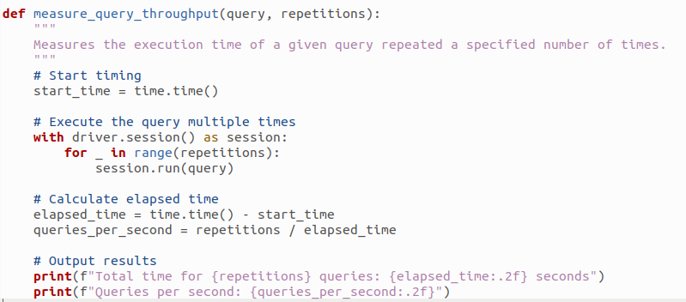
Throughput

Slide 14
Throughput Results
Query 1: Total time for 100 queries: 7.02 seconds
Queries per second: 14.25
Query 2: Total time for 100 queries: 2.62 seconds
Queries per second: 38.13
Query 3: Total time for 100 queries: 98.71 seconds
Queries per second: 1.01
Query 1: Total time for 100 queries: 6.15 seconds
Queries per second: 16.27
Query 2: Total time for 100 queries: 4.86 seconds
Queries per second: 20.57
Query 3: Total time for 100 queries: 18.76 seconds
Queries per second: 5.33

Slide 15
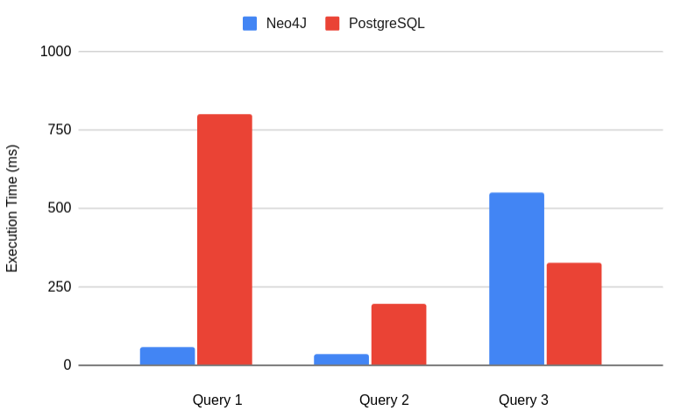
Results

Slide 16
Conclusions
The tabular representation of the dataset in PostgreSQL played a significant role in its performance for relational queries. Since the data was stored in a structure that closely matched the relational model, PostgreSQL executed the third query with better execution time.
In the case of the other two queries Neo4J performed better.

